Slide 1
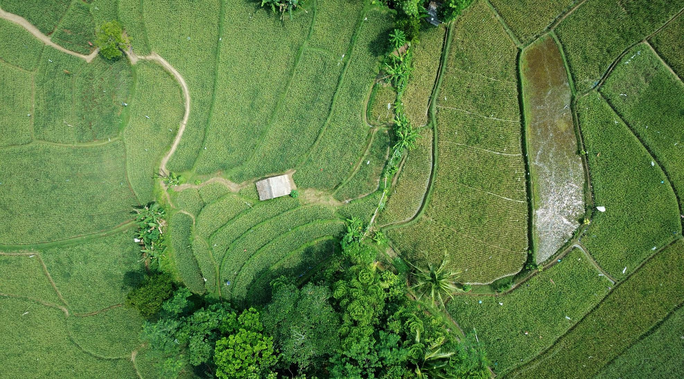
Use remote sensing through the cloud platform To Investigate vegetation cover in the primary region of Oceania
Alice YU

Slide 2

About Backgound
Since the successful launch of the first US weather satellite in 1960, remote sensing technology has developed rapidly, and the Earth orbit is full of a variety of Earth observation satellites on a global scale. Mankind has accumulated historical remote sensing data for nearly half a century.
The "5V" features of remote sensing
large Volume, Variety,Velocity, Veracity and Value

Slide 3



Why we can avail remote sensing through cloud plaform ?
The cloud has massive data resource, and there is no need to download them locally
The access threshold of using remote sensing data is lower, and the computing efficiency is greatly improved
Cloud
Platform
The cloud provides Application Programming interfaces (apis) without the need to install software locally

Slide 4


What cloud plaform can we use ?
Connects GEE’s API
imports GEE’s data product
Google Earth Egine
Google calaboratory
Provides a set of apis for Python and a number of data product
Colab's code runs on Google's cloud servers and has Jupyter notebook environment which can be used without any setup

Slide 5
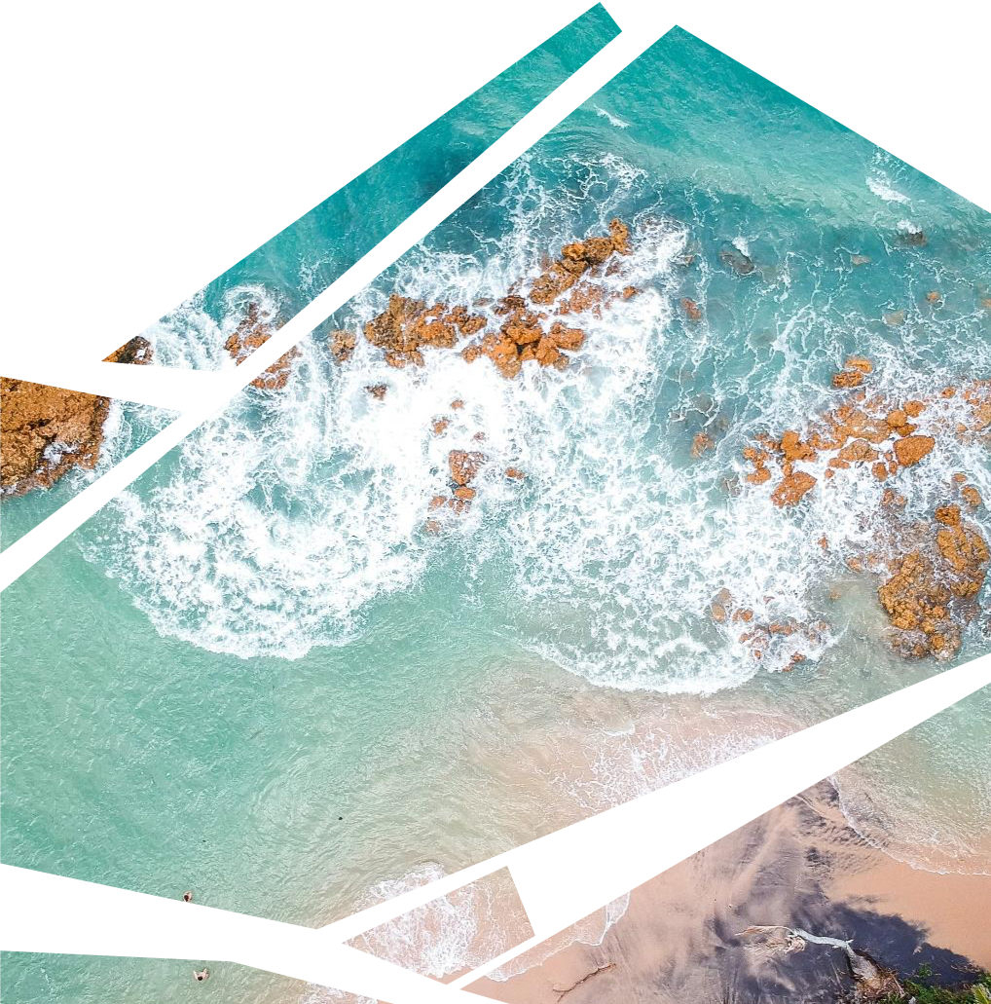



The Outline
Project Objective
Study the variation of global vegetation cover
Research Process
*Researching Methods
*Data visualizationan
Analysis and Problems
*Result analysis
*Researching limitation

Slide 6

1
Part.
Project Objective
关于福州

Slide 7
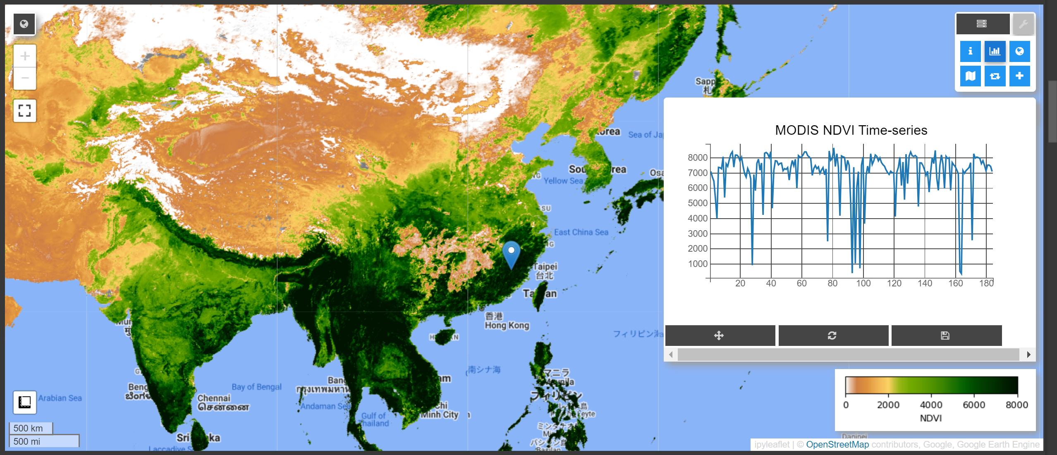
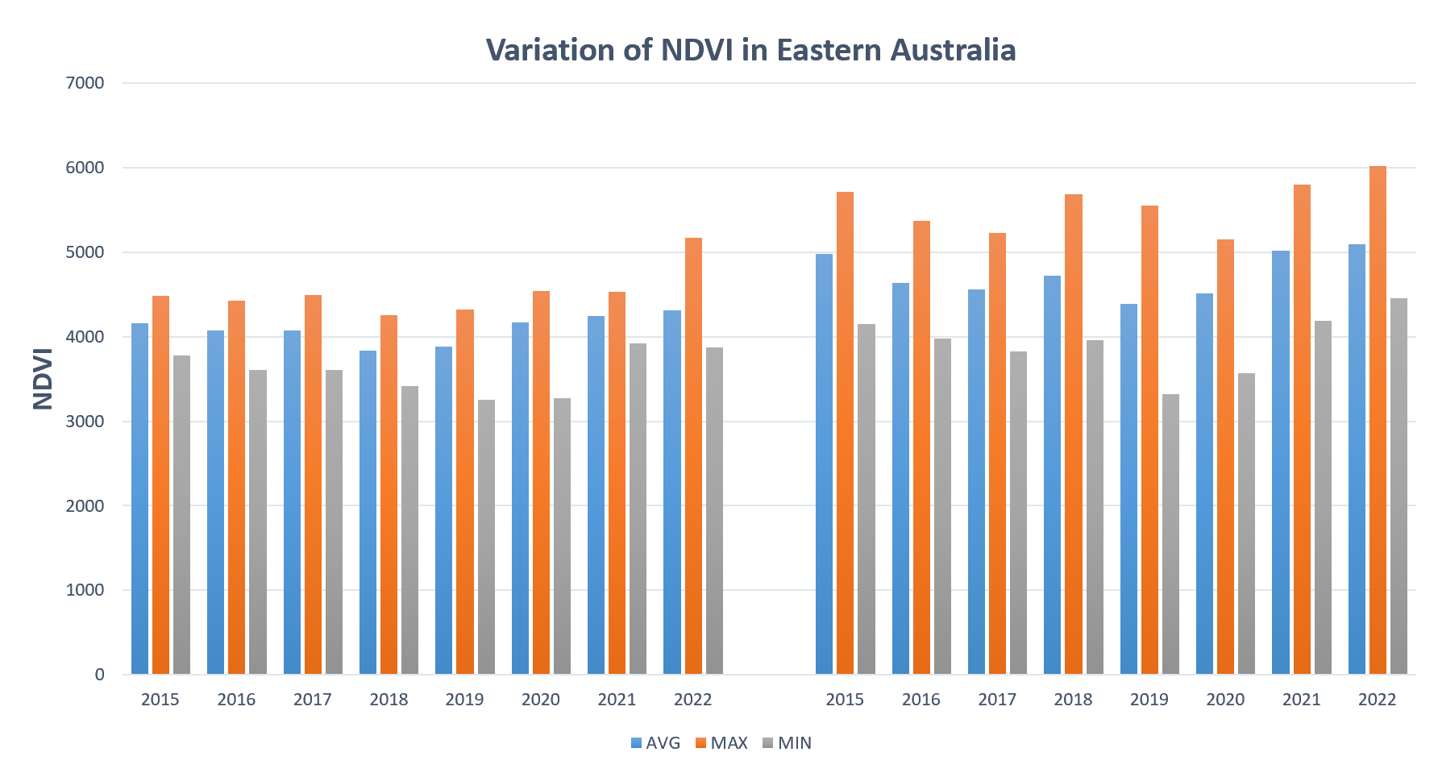
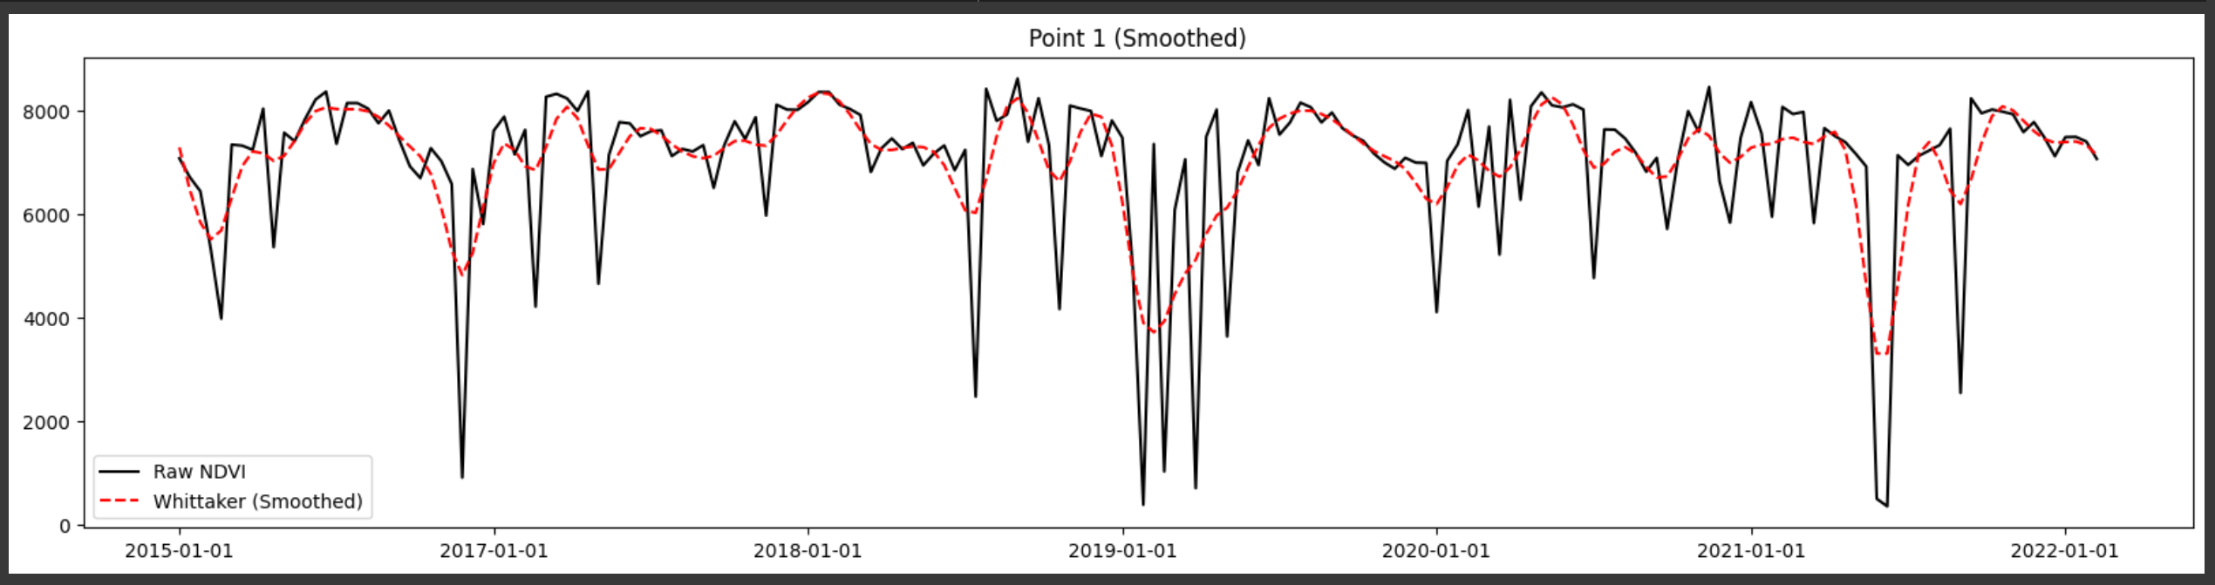
Project
Objective
Google calaboratory

Slide 8
2
Part.
Research
Process
关于福州

Slide 9
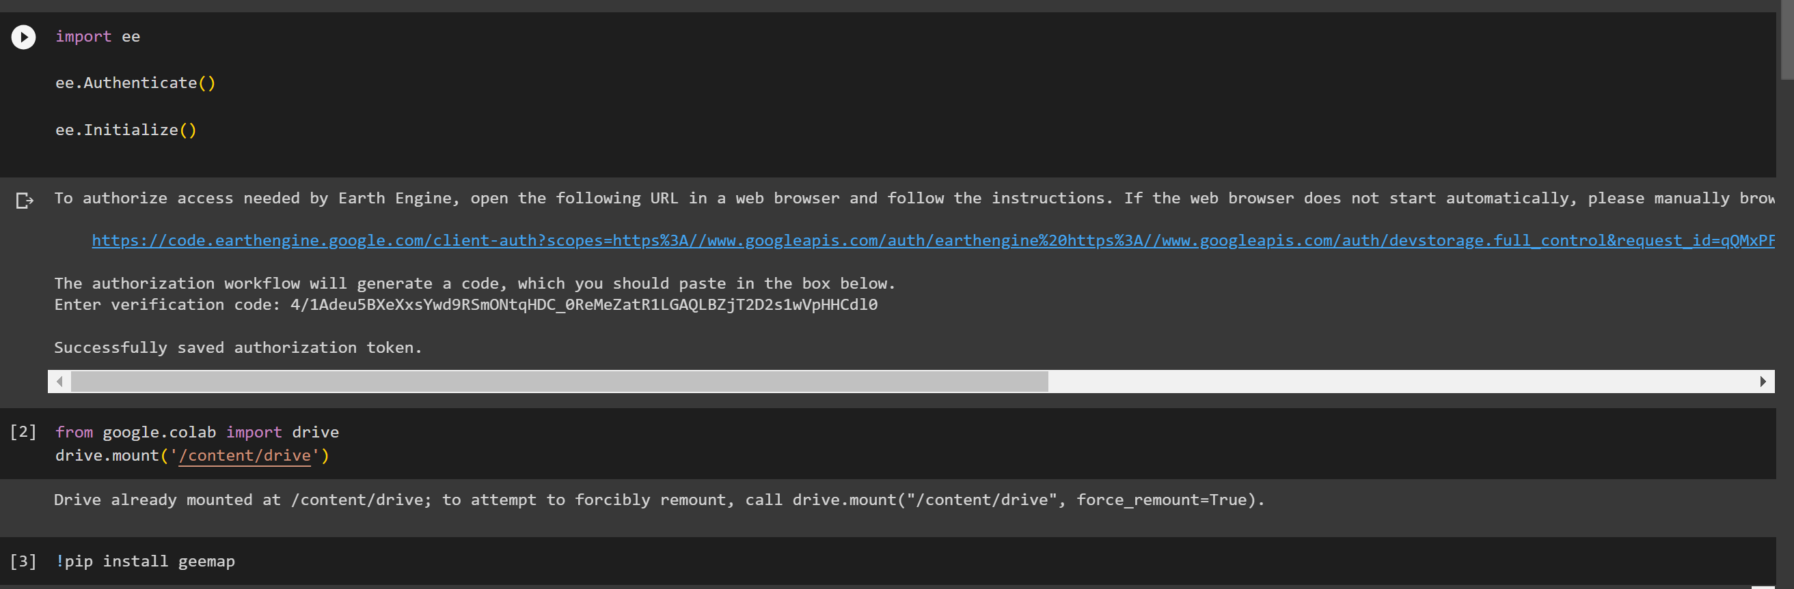
Step 1
Import the ee module for interacting with Google Earth Engine
Gain access and initialization
Import the Google drive module of Colab to connect to the Google Cloud drive
Install and import the geemap library for map visualization and geospatial data analysis

Slide 10
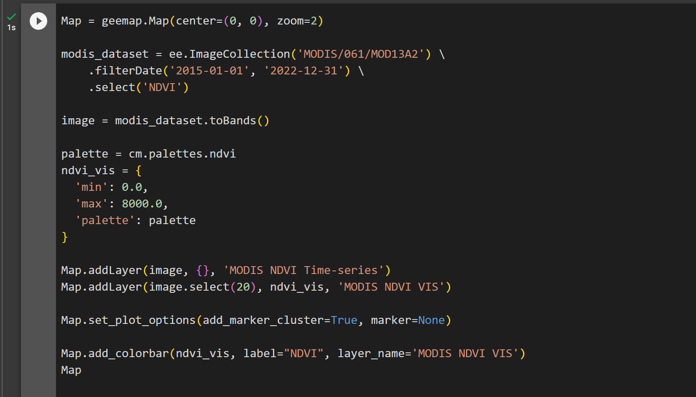
Step 2
Choose a suitable data product from Google Earth Engine
Create an interactive Map object
Import tha data product MOD13A2.061
Set observation time from 2015 to 2022
Selct NDVI indice
The data set is transformed into an image, represented as a time series
Get color mapping
Set the visual parameters of NDVI
Add layers to the map to display:
MODIS NDVI time series and visualization results
Sets plotting options for adding marker clusters and markers to the map

Slide 11
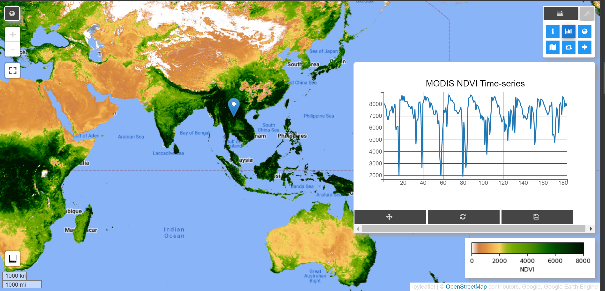
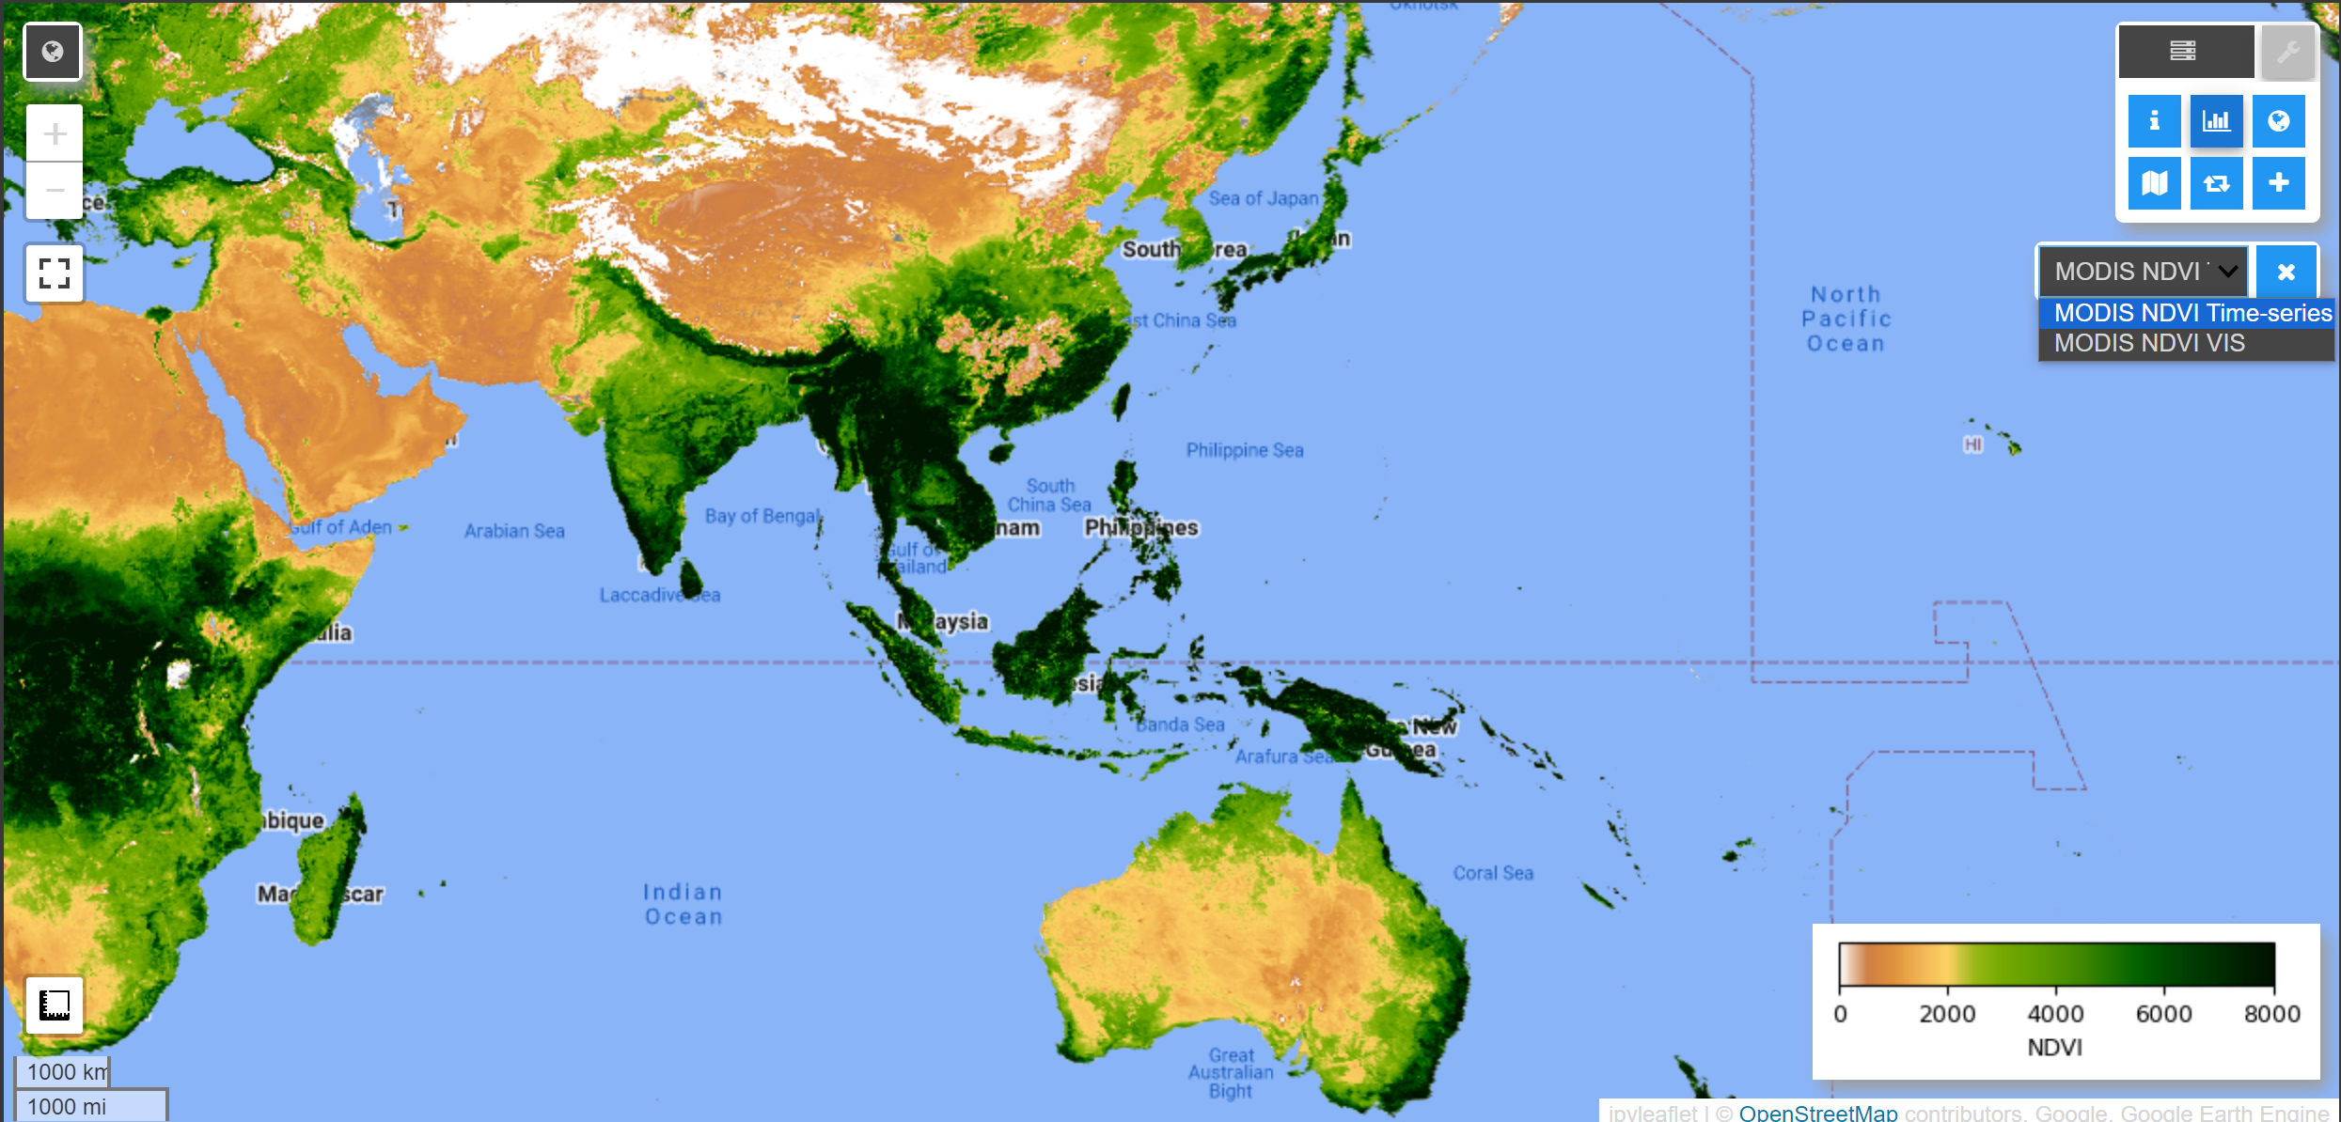
Step 2

Slide 12
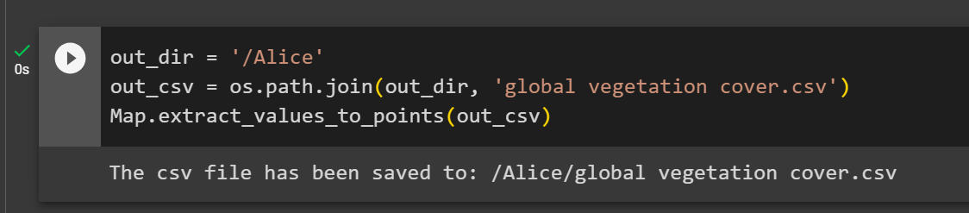
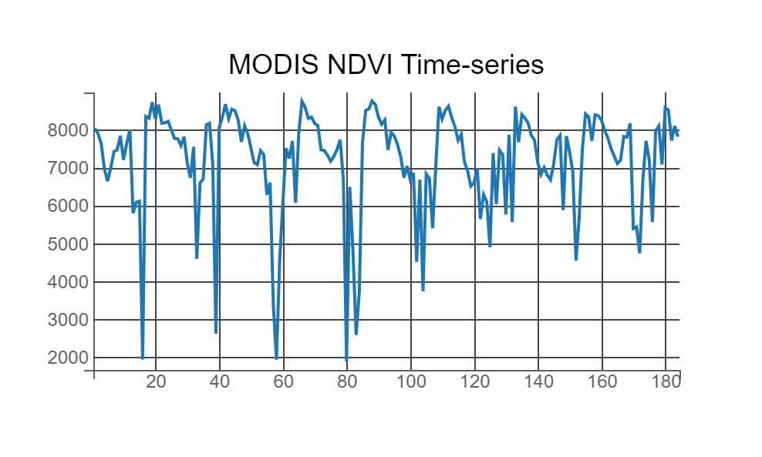
Step 3
Geemap can record all the points clicked by the user, so I set the path in order to output CSV file
Extract numerical data from maps to CSV files
I found that the generated line chart had a big fluctuation
Whittaker Smoother method

Slide 13
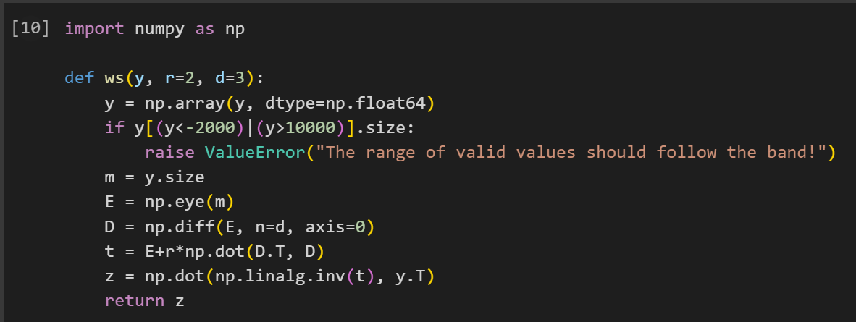
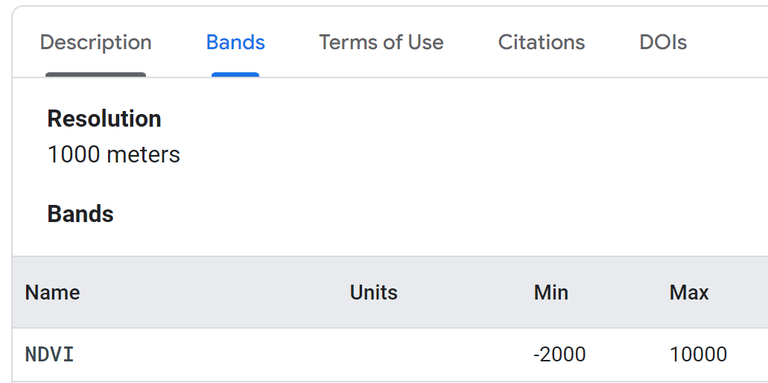
Step 3

Slide 14
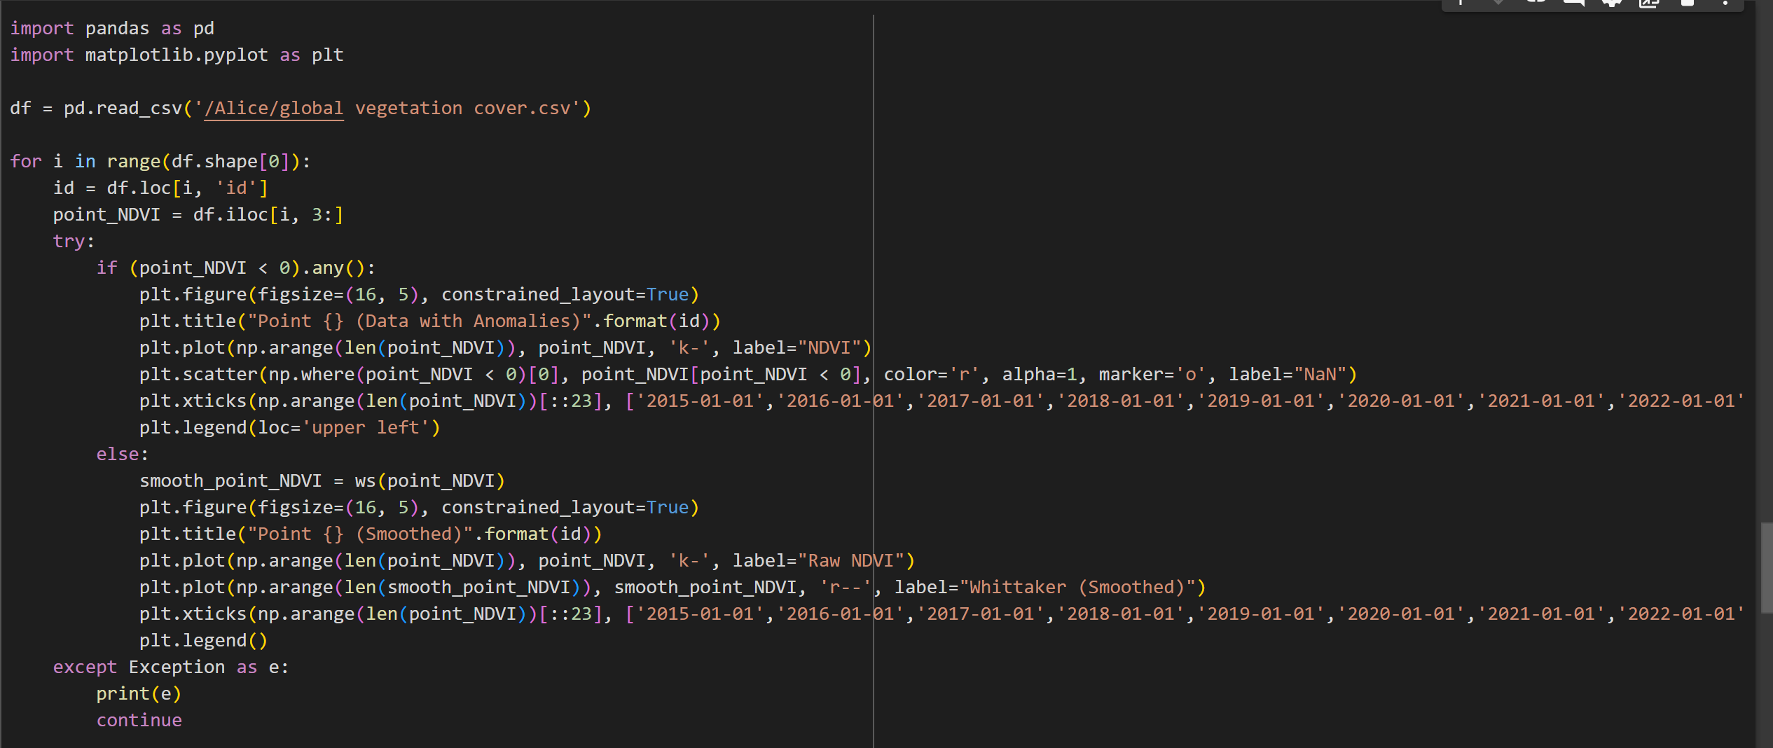
Step 4
Use the data collected in the previous step to draw a line graph
Detect whether there are values less than 0
Draw red dots on the graph to indicate the location of the outlier
Draw raw NDVI data and NDVI data smoothed by Whittaker line charts

Slide 15
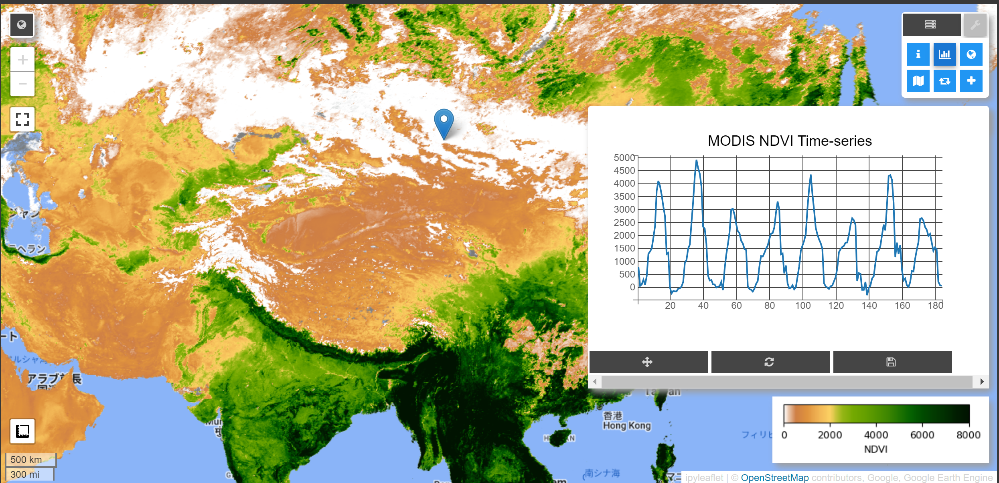
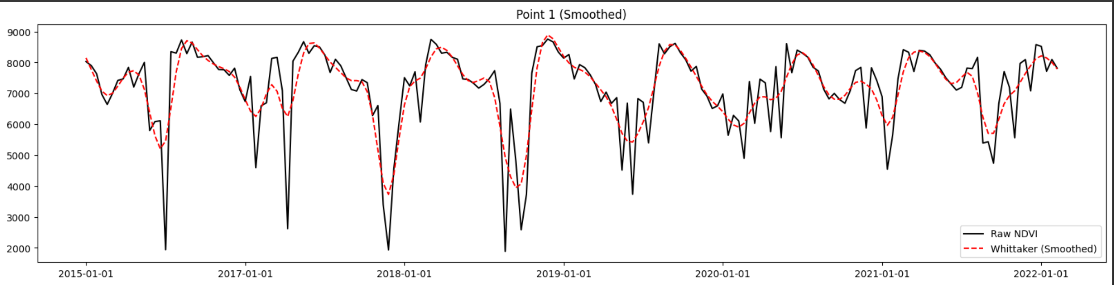
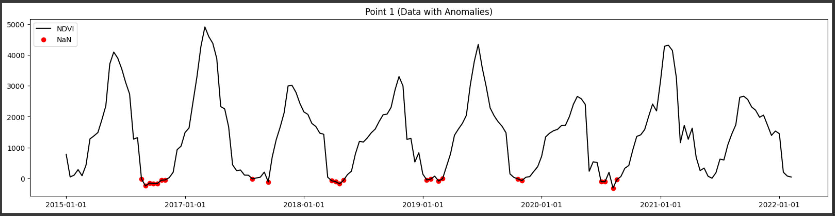
Step 4

Slide 16
3
Part.
Analysis
and
Problems
关于福州

Slide 17

Summary
Eastern Australia – Sydney, Brisbane
Western Australia – Great Sandy Desert, Great Victoria Desert
New Zealand – Wellington, Christchurch
vegetation cover in the primary region of Oceanian

Slide 18
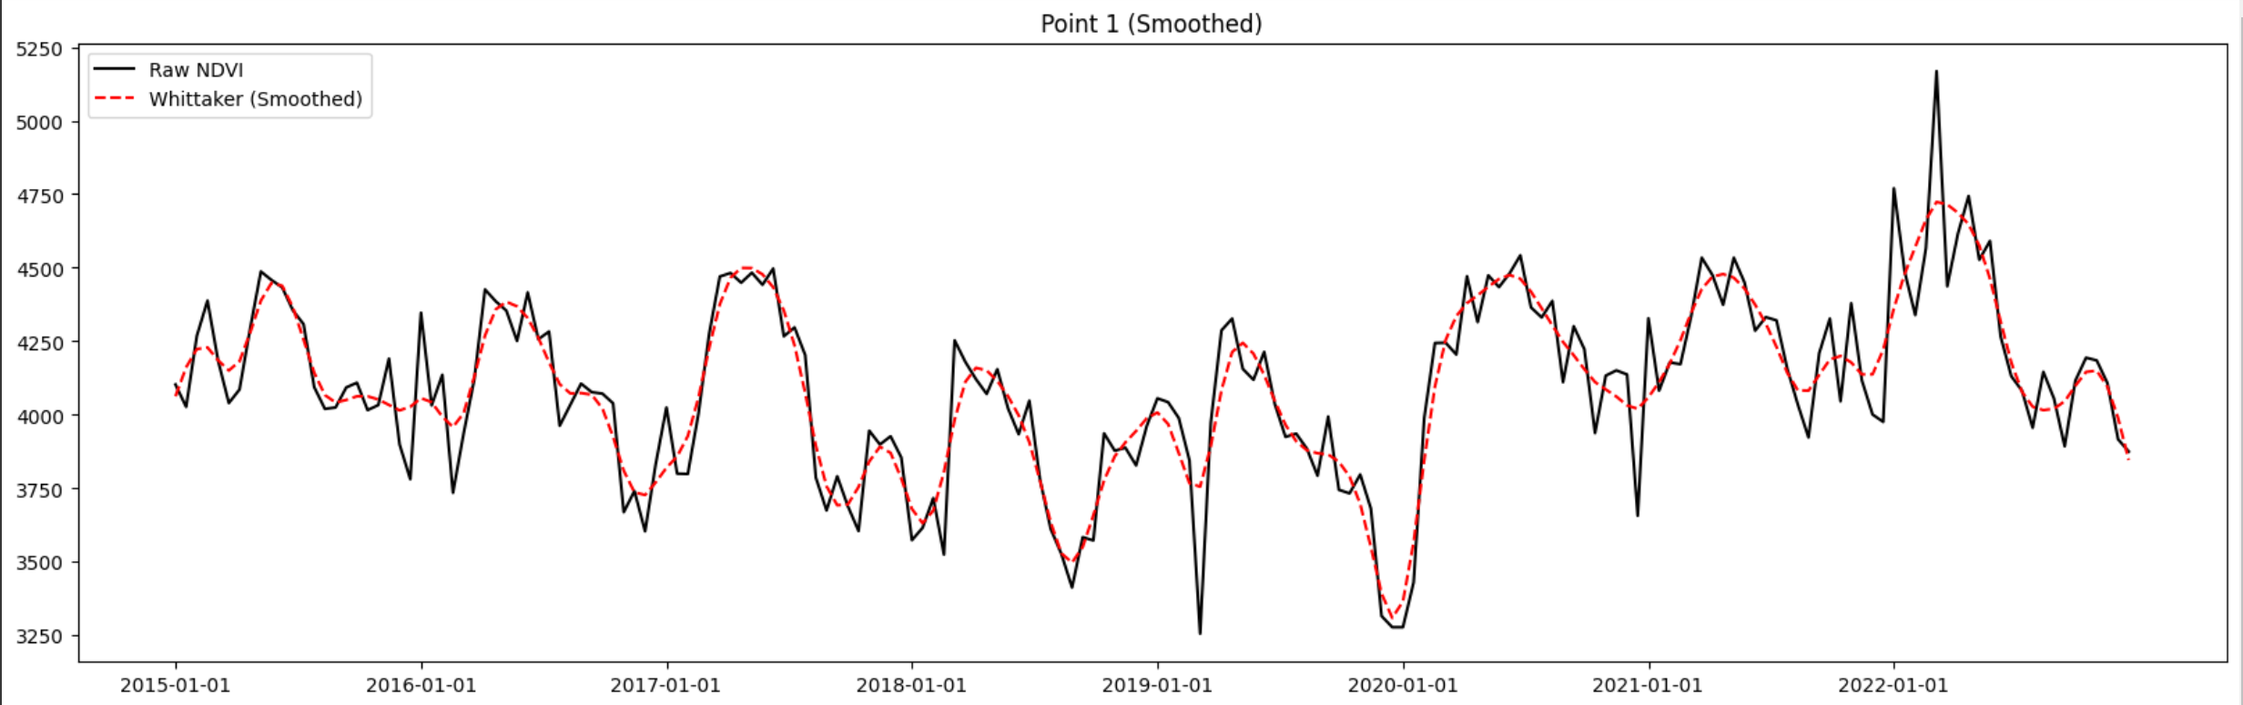
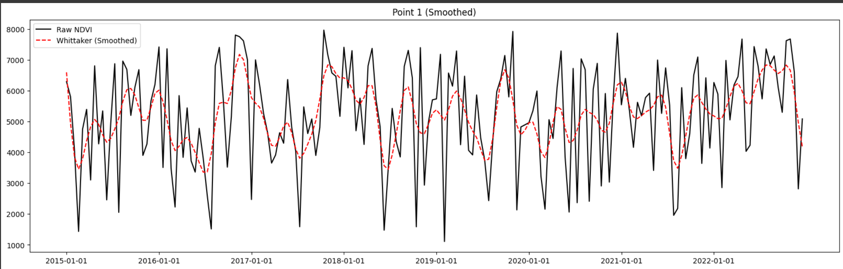
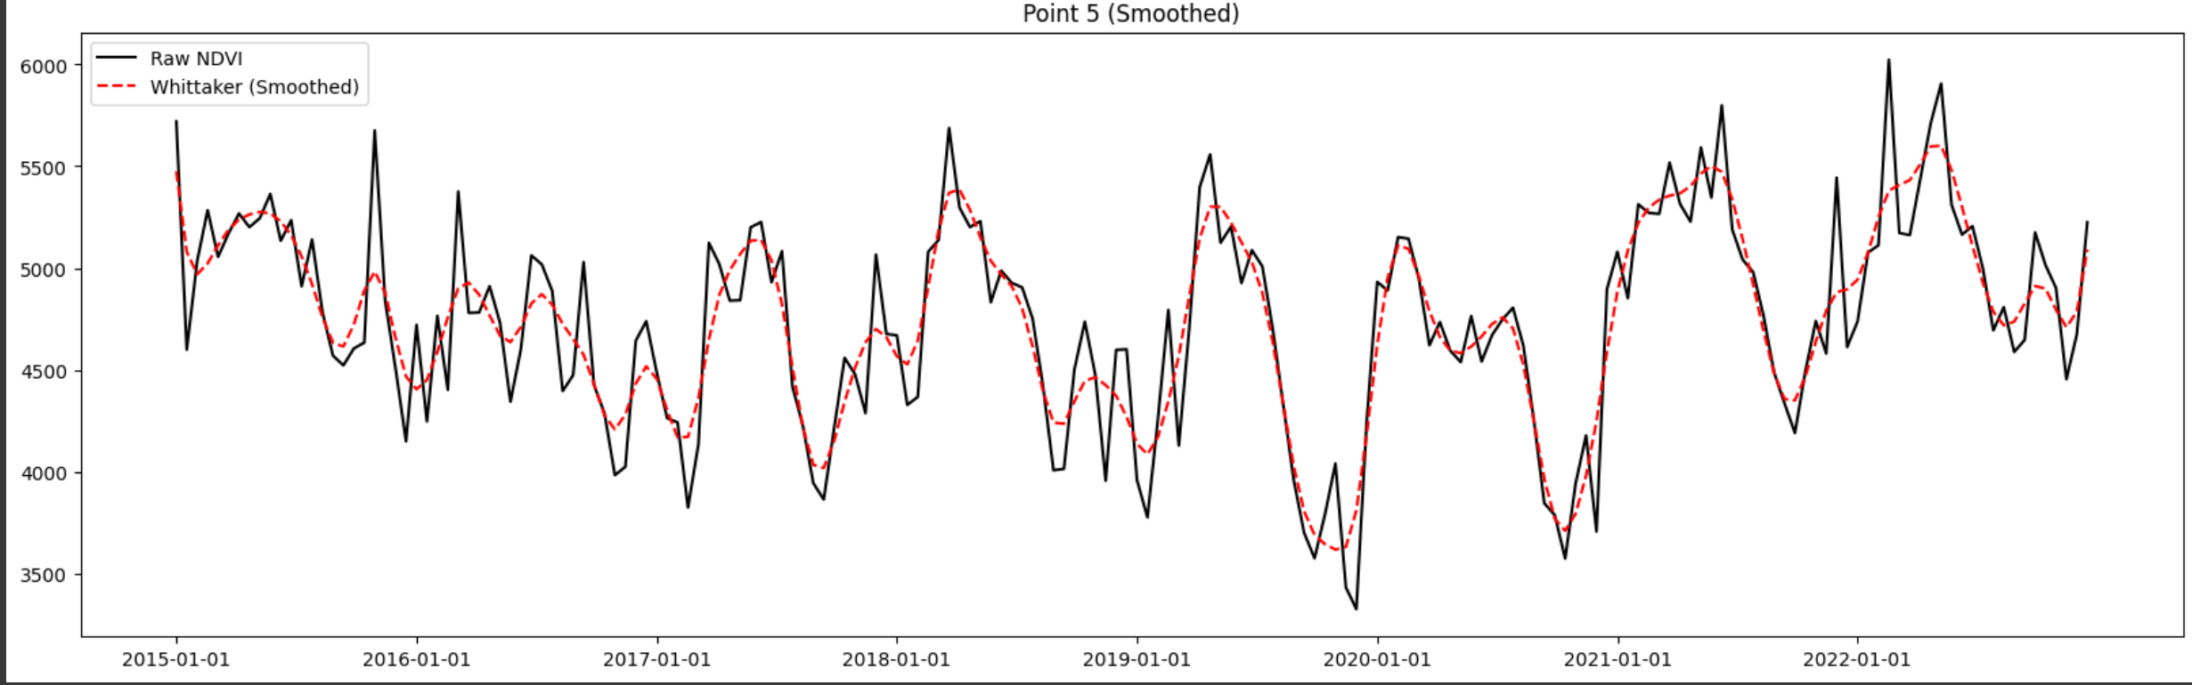
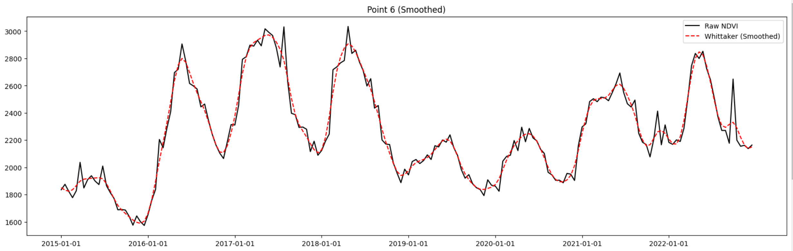
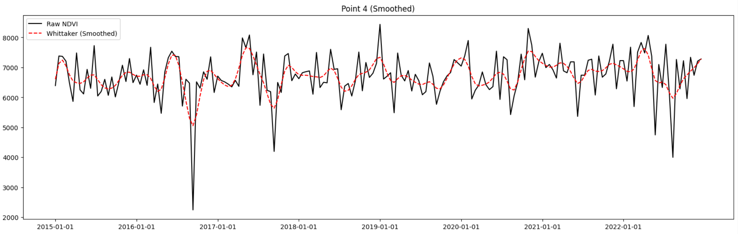
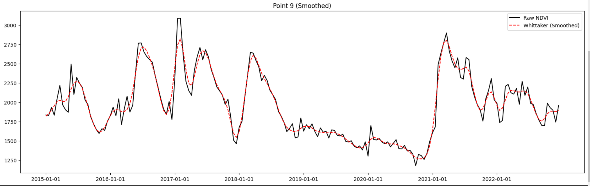
Results Analysis

Slide 19
Results Analysis
Queensland Brisbane
New South Wales Sydney
Indicate
increase

Slide 20
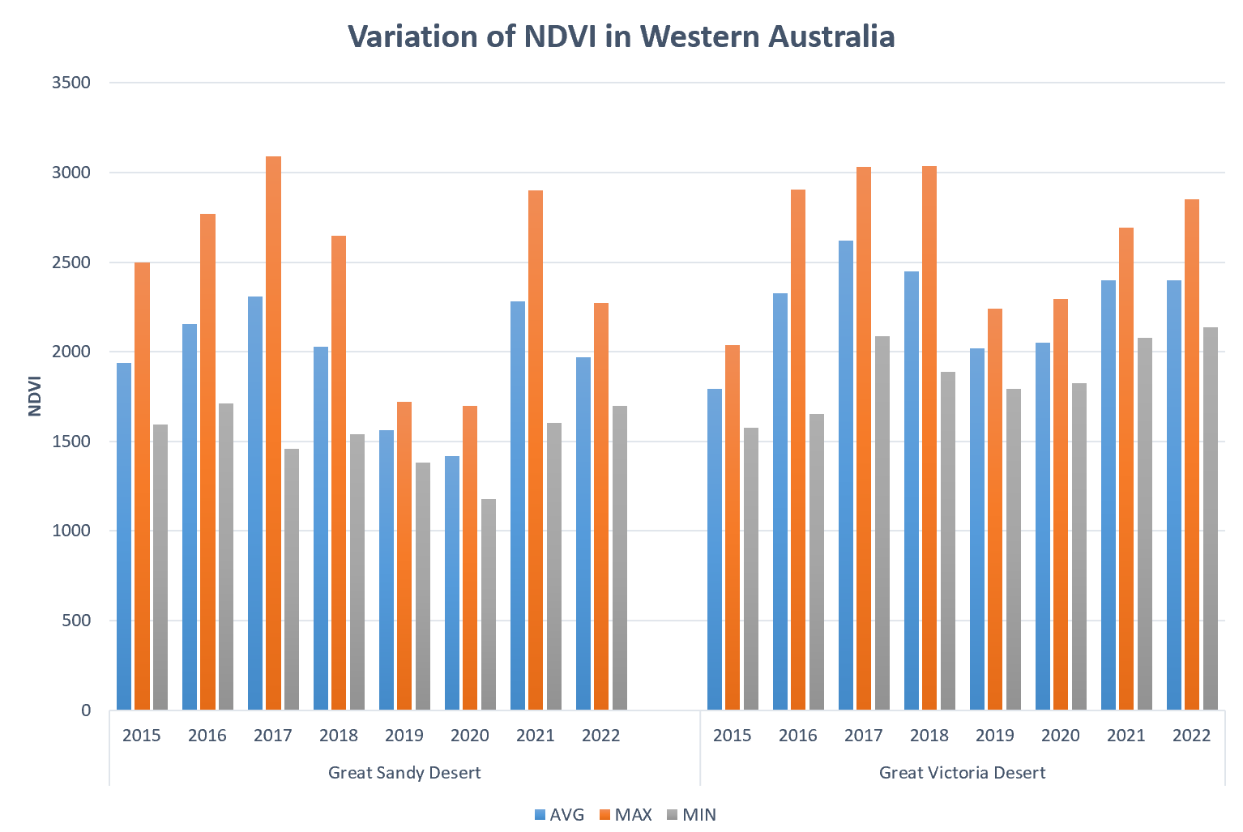
Results Analysis
Indicate fluctuation
Positive prospect

Slide 21
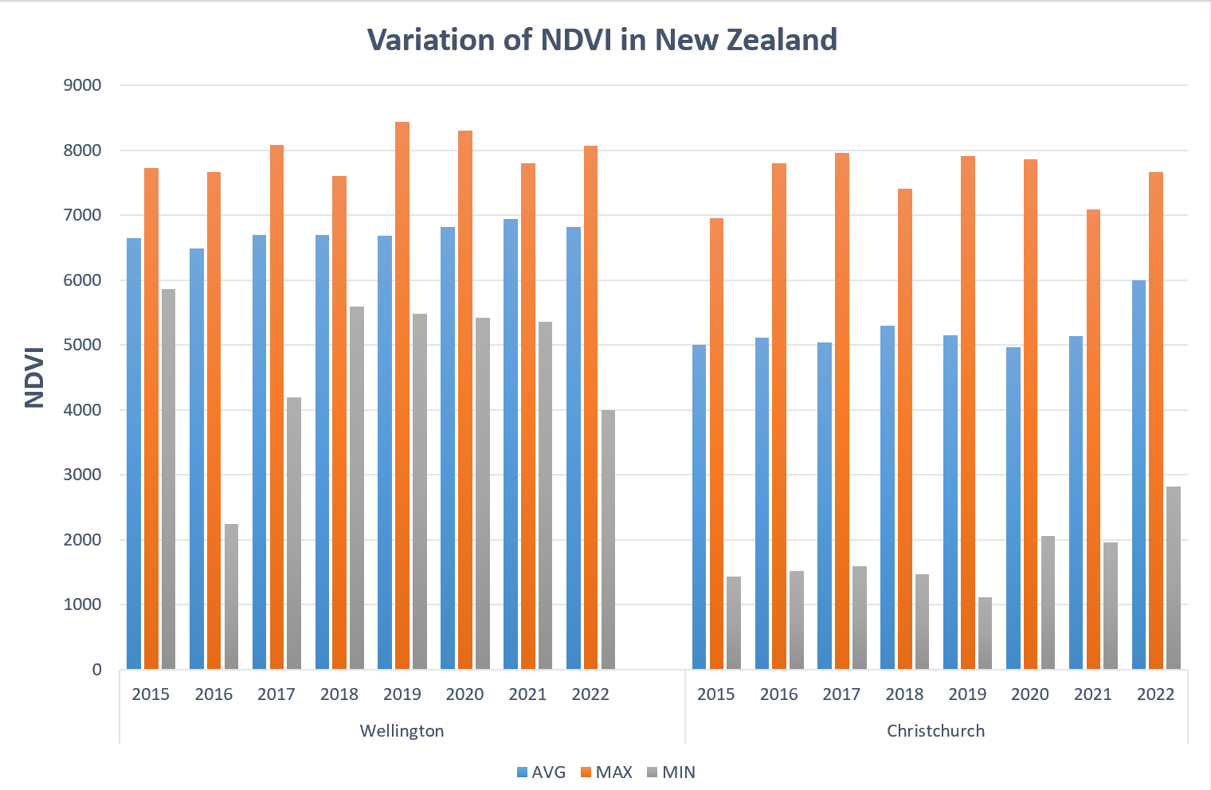
Results Analysis
Indicate
Increase

Slide 22
Results Analysis
Region | Population | Climate Type | AVG NDVI (2015-2019)
New South Wales Sydney | 5.312 million (by 2019) | Subtropical monsoon humid climate (precipitation depends on monsoon) | 4094.261
Queensland Brisbane | 2.28 million (by 2016) | Subtropical humid climate | 4741.701
Wellington | 212,700 (by 2017) | Temperate marine climate | 6726.766
Christchurch | 381,500 (by 2017) | Temperate marine climate | 5215.587

Slide 23
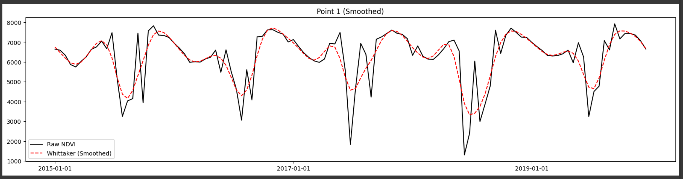
Limitations

Slide 24
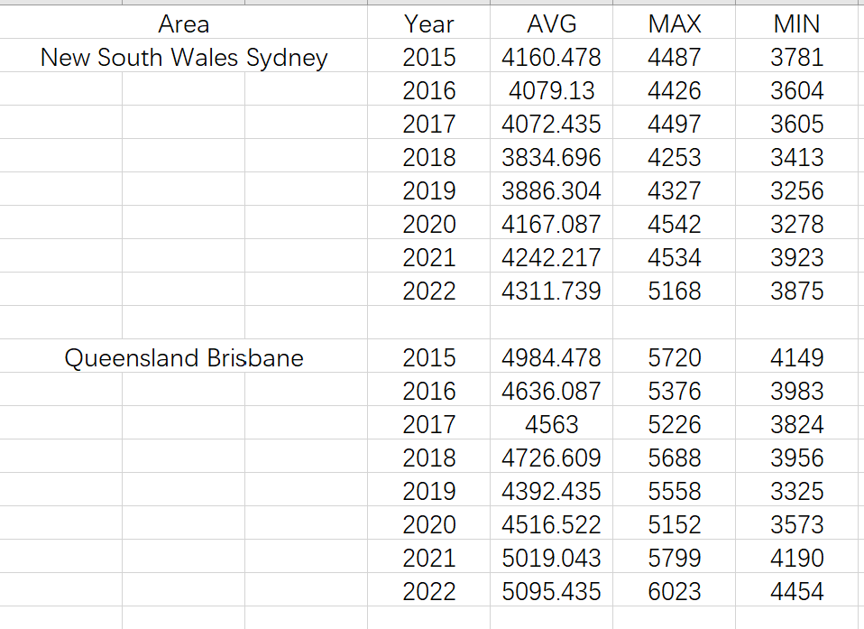
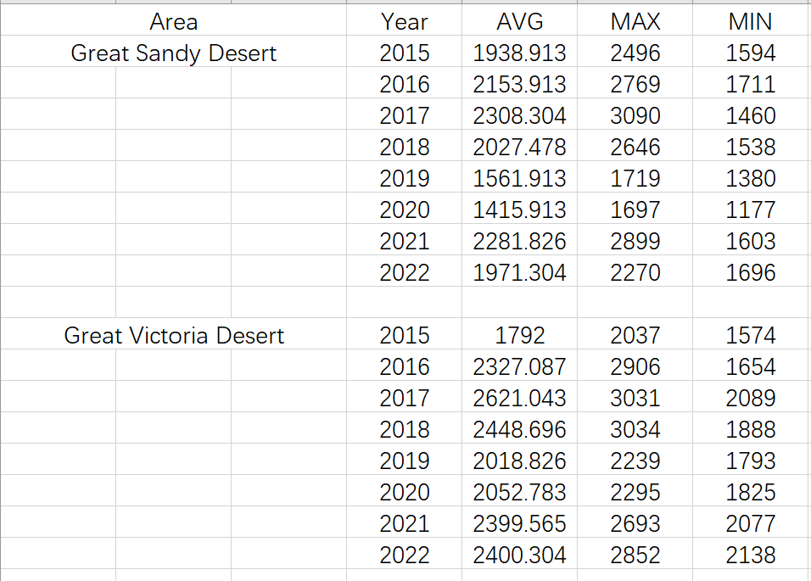
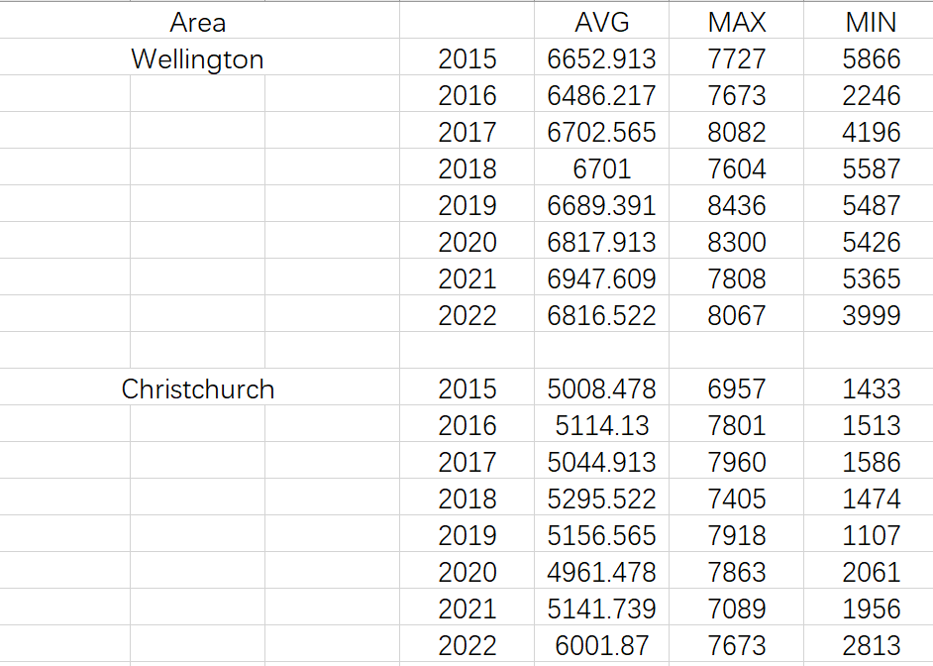
Limitations
Only partial data points for these countries or cities are selected
Cannot be a fully representative of their region

Slide 25
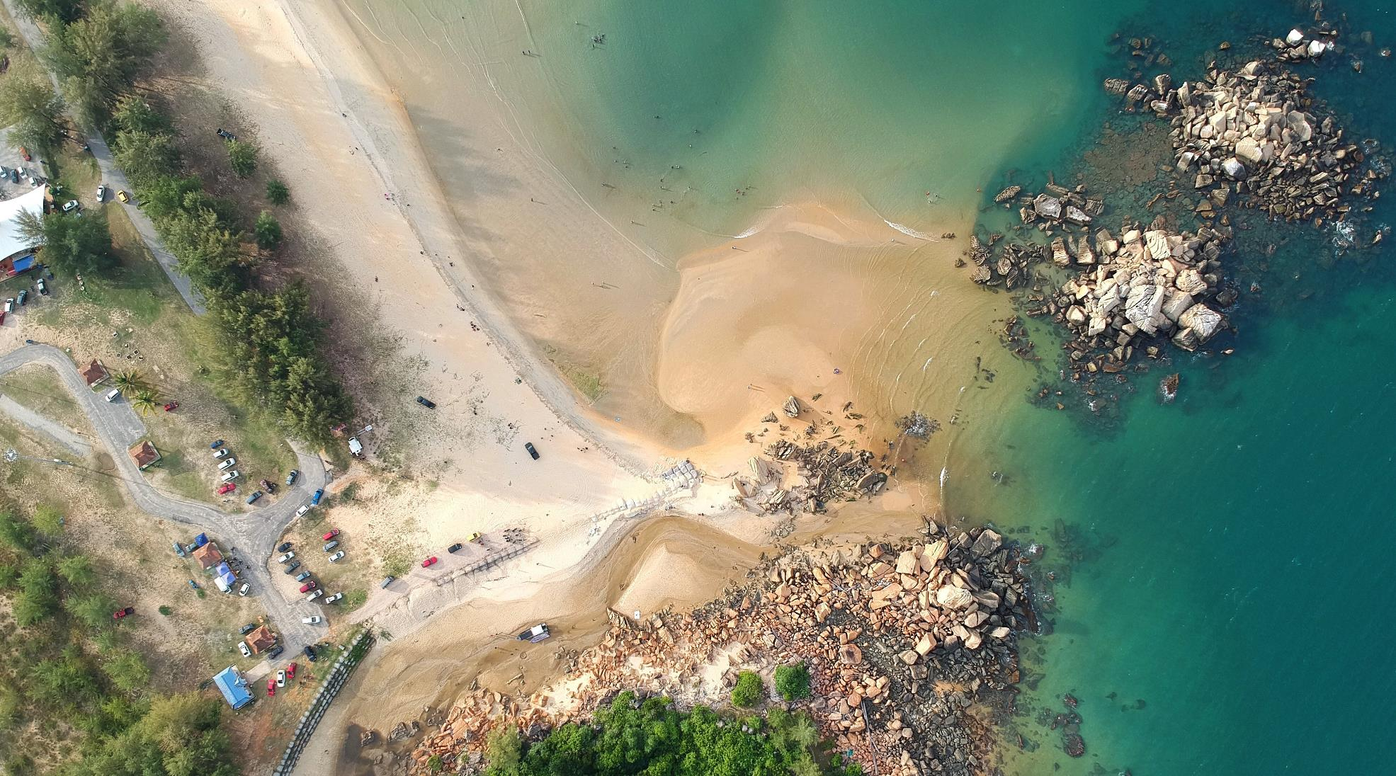



Thank You
+86 18359772981
1552480915@qq.com
https://github.com/123111222/GEE_Cloud-computing

